Slide 1
Decision Tree

Slide 2
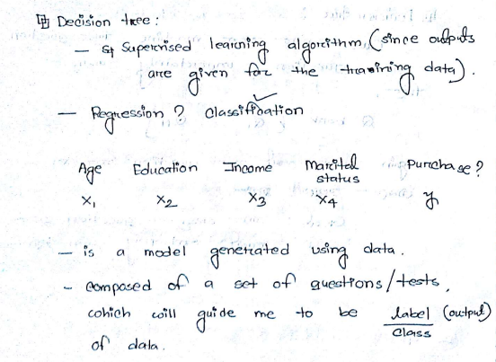
Decision Tree

Slide 3
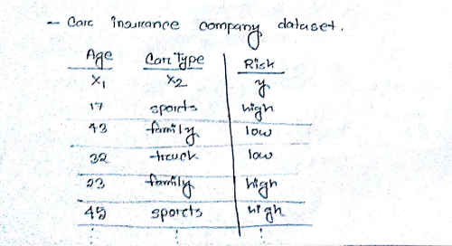
Decision Tree(Cont.)

Slide 4
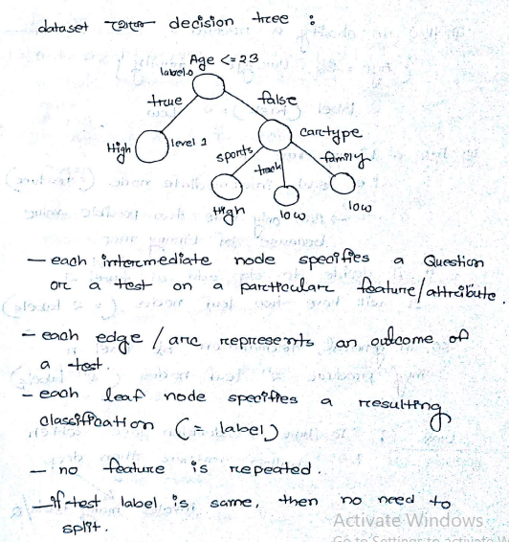
Decision Tree(Cont.)

Slide 5
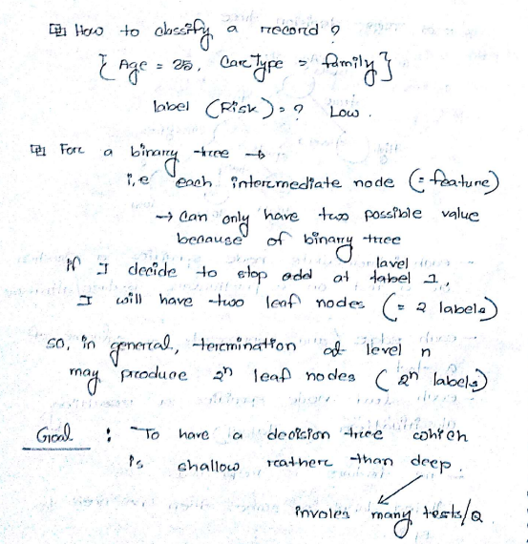
Decision Tree(Cont.)

Slide 6
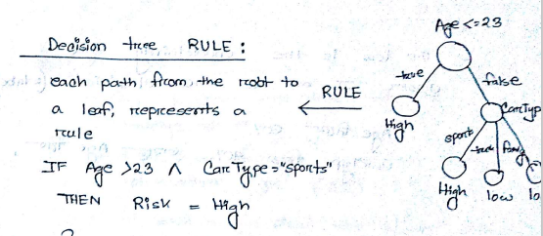
Decision Tree(Cont.)

Slide 7
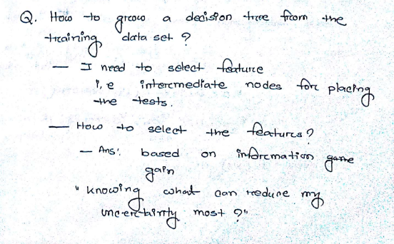
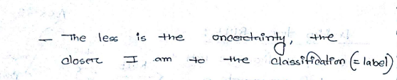
Decision Tree(Cont.)

Slide 8
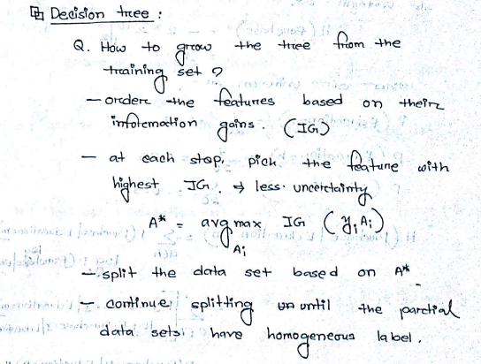
Decision Tree(Cont.)

